Slide 1

Unified Home Study Training
EMERGENCY PLACEMENT
HOME STUDY
Office of Child welfare
April/May 2018

Slide 2

Learning Objectives
Identify what information needs to be gathered and assessed in an Emergency Placement Home Study for a relative or non-relative placement.
Demonstrate how to gather the necessary information for the Emergency Placement Home Study.
Demonstrate how to document an Emergency Placement Home Study using FSFN.
Unified Home Study 2.2

Slide 3
Emergency Placements
A removal of a child may occur at any hour day or night. This means CPIs are making placements where exigent circumstances exist.
Exigent circumstances, as defined in 65C-30.01(42), F.A.C., are situations where it is anticipated that a child will be placed with a relative or non-relative within 72 hours.
Unified Home Study 2.3

Slide 4
Information Gathering
Gather as much information as possible.
Gather caregiver’s interest and demographic information.
Assess the level of care a child needs via the Placement Assessment.
Identify and evaluate potential caregivers.
Unified Home Study 2.4

Slide 5

FSFN Tutorial
Demographic Information
Unified Home Study 2.5

Slide 6
Demographic Information
CPIs must gather demographic information on all household members and adult visitors to the home who provide care of the child outside of the caregiver’s ability to provide sight and sound supervision.
Unified Home Study 2.6

Slide 7
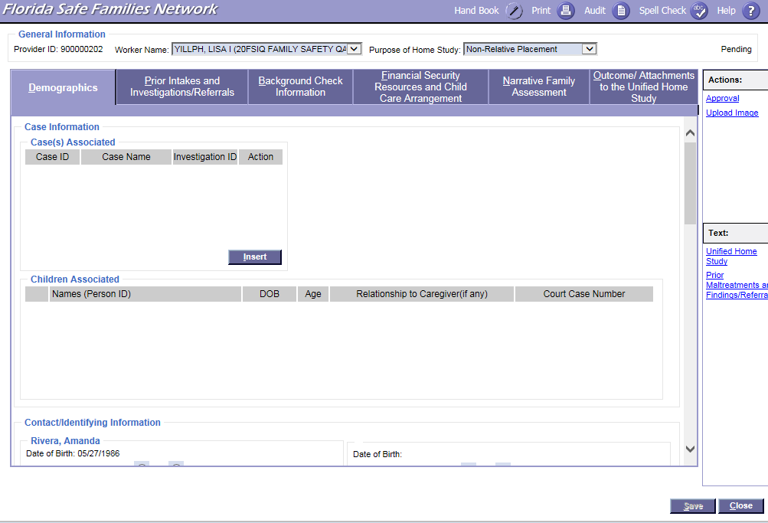

FSFN Screens
UHS Demographics tab:
Unified Home Study 2.7

Slide 8
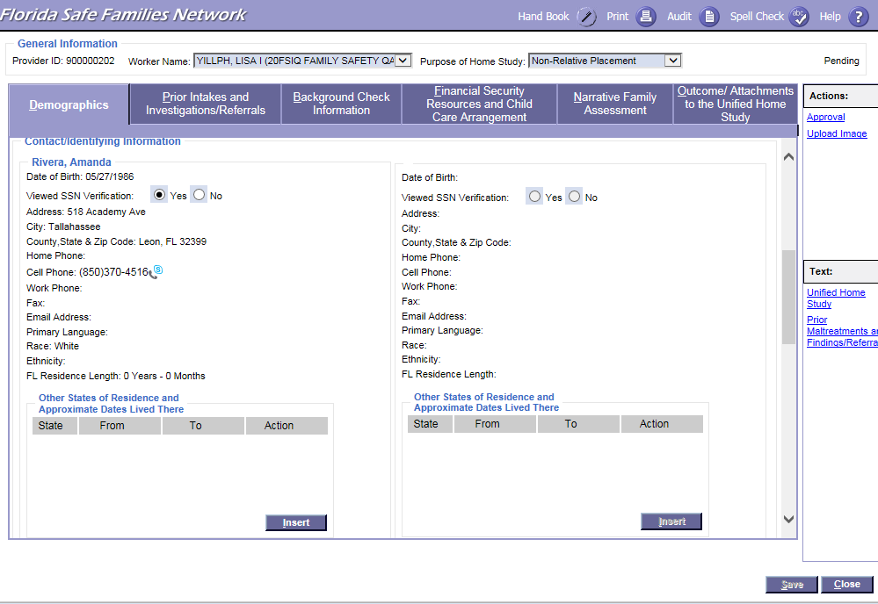
FSFN Screens
UHS Demographics tab:
Unified Home Study 2.8

Slide 9
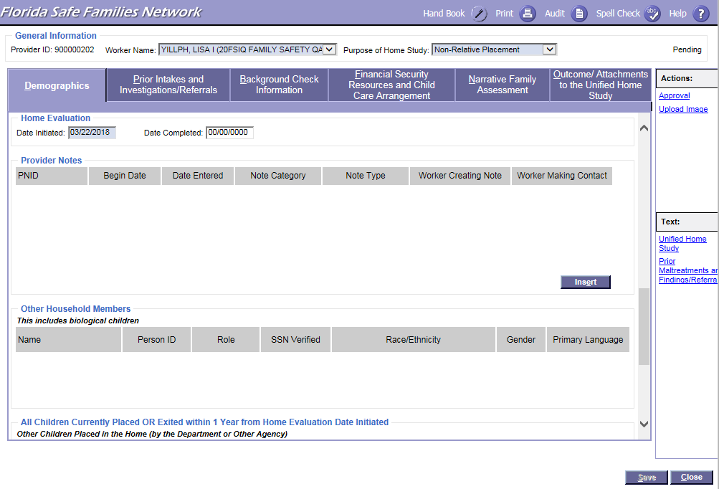
FSFN Screens
UHS Demographics tab:
Unified Home Study 2.9

Slide 10
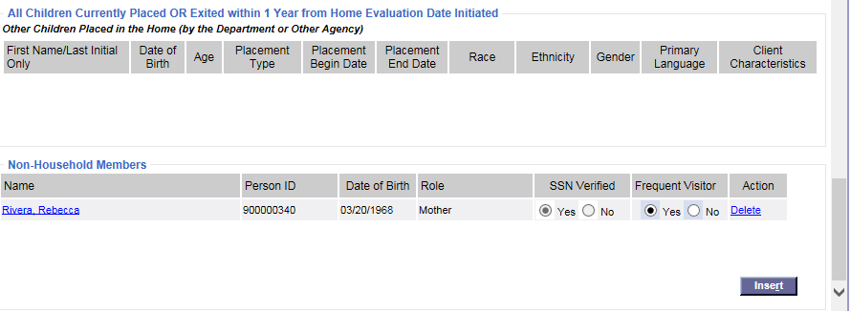
FSFN Screens
UHS Demographics tab:
Unified Home Study 2.10

Slide 11
FSFN Tutorial
Background
Checks
Unified Home Study 2.11

Slide 12
Background Checks
CPIs must obtain and assess background checks of all household members over the age of twelve, and frequent visitors over the age of 18 who provide sight and
sound supervision.
Telephone
FSFN
CIU
Unified Home Study 2.12

Slide 13
Background Checks, con’t.
Abuse/
neglect record checks
Local criminal/
probation checks
Juvenile Justice information
FCIC/
sexual predator
NCIC
Fingerprint submission
Unified Home Study 2.13

Slide 14
Analysis of
Background Checks
A thorough review and analysis of all of the background information gathered provides CPIs with the insight needed in order to ensure that the BEST possible placement is made for the child.
When reviewing the criminal, abuse, and/or neglect records obtained, CPIs must assess for patterns of criminal behavior that may place the child in danger.
Unified Home Study 2.14

Slide 15
Disqualifiers
While performing background checks, Child Welfare Professionals may find information that automatically disqualifies a person from being a placement candidate.
Unified Home Study 2.15

Slide 16
Disqualifiers, con’t.
Offenses that disqualify a person include:
Child abuse, abandonment,
or neglect
Child pornography or other felony involving a child
Domestic violence
Homicide, sexual battery, or other felony involving violence
Unified Home Study 2.16

Slide 17
Disqualifiers, con’t.
Children cannot be placed with a person who has been convicted of a felony, within the last five years, within the following categories:
Assault
A drug-related offense
Battery
Resisting arrest with violence
Unified Home Study 2.17

Slide 18
Documentation
Within FSFN, CPIs must document the records obtained and their thorough analysis of the background check results within the Background Check Information page.
Unified Home Study 2.18

Slide 19
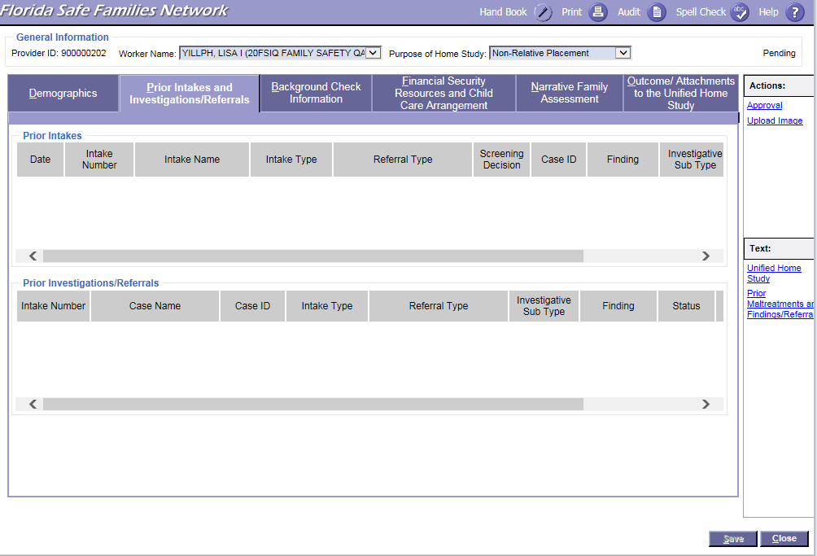
FSFN Screens
Prior Intakes Investigations/Referrals:
Unified Home Study 2.19

Slide 20
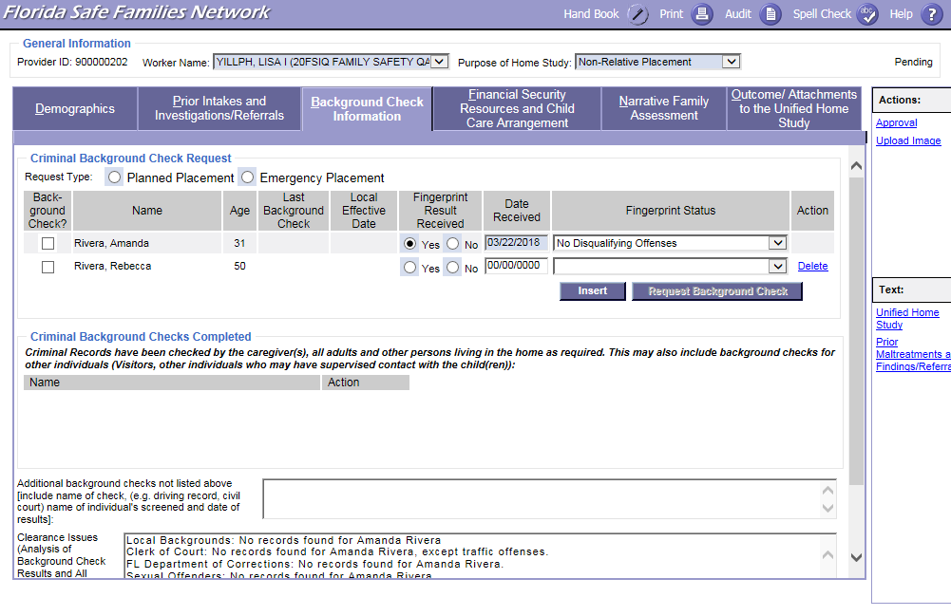
FSFN Screens
Requesting Background Checks:
Unified Home Study 2.20

Slide 21
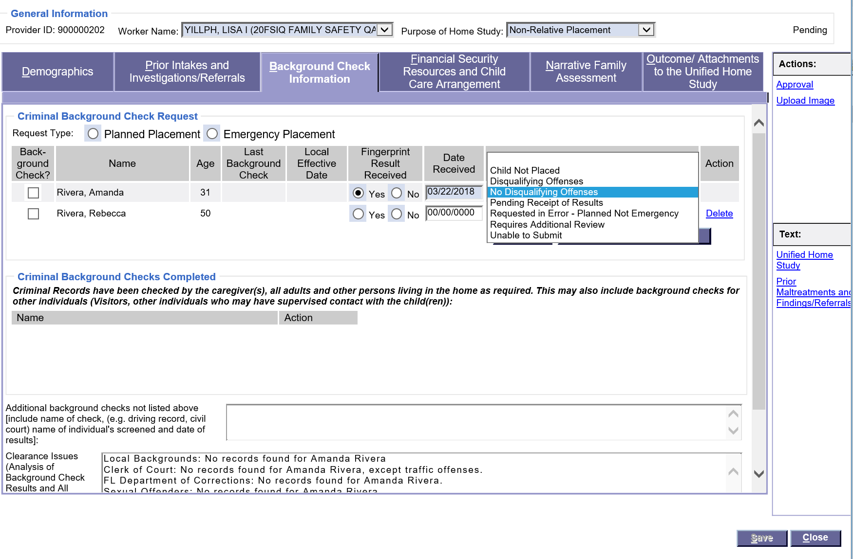
FSFN Screens
Documenting Background Check Results and Analysis:
Unified Home Study 2.21

Slide 22
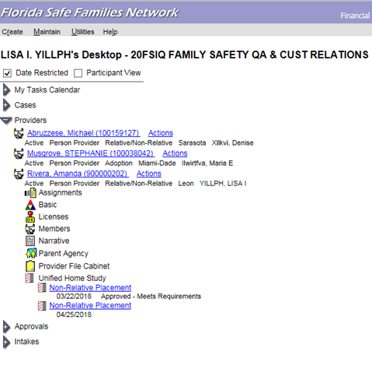
FSFN Screens
Updating criminal history dates:
Unified Home Study 2.22

Slide 23
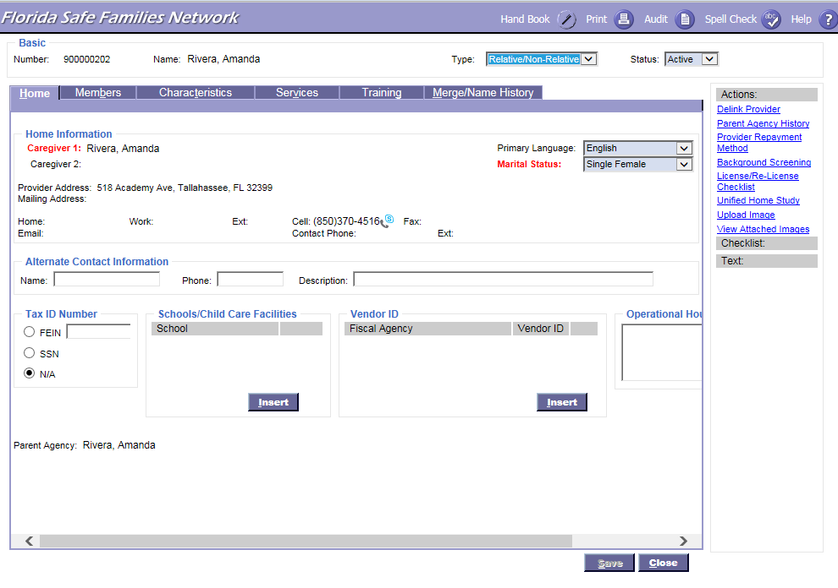
FSFN Screens
Updating criminal history dates:
Unified Home Study 2.23

Slide 24
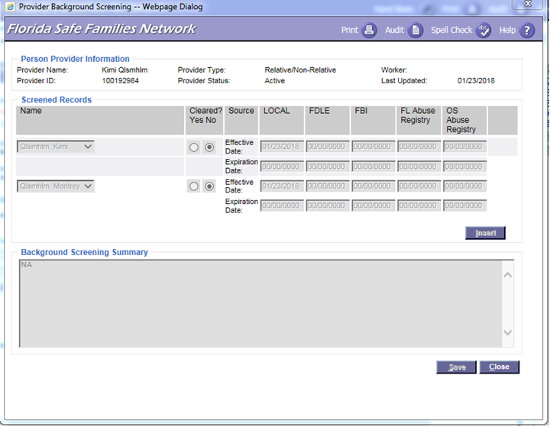
FSFN Screens
Where to insert clearance from different sources:
Unified Home Study 2.24

Slide 25
Information Needed Prior to Emergency Placement
Background Checks
Interview
Home Evaluation
Verbal Supervisory Approval
Unified Home Study 2.25

Slide 26
Interviews
During interviews, CPIs need to speak with the prospective caregiver(s) about:
The danger threats creating the child’s need for out-of-home care.
Any special medical needs the child has, including current medications.
The ability and willingness of the caregiver(s) to protect and care for the child. This includes whether or not the caregiver is aligned with the child.
Unified Home Study 2.26

Slide 27
Interviews, con’t.
During interviews, CPIs need to speak with the prospective caregiver(s) about:
The shelter process to include immediate court proceedings.
Their rights and responsibilities as a caregiver.
Support and resources available to the caregiver, such as relative/non-relative caregiver funds, Medicaid, at-risk daycare, and/or local flex funds.
Unified Home Study 2.27

Slide 28
Home Evaluation
A home evaluation includes a walk-through of the home and discussion and observation of the child’s sleeping arrangements. It is important to ensure that the living environment is free of any potential hazards and that sleeping arrangements are appropriate for the age of the child.
Unified Home Study 2.28

Slide 29
Caregiver Supports
Medical Insurance (Medicaid)
“At-risk” Child Care Referral
“Child-only” Temporary Cash Assistance
Relative Caregiver Program (RCP)
Non-Relative Caregiver Program (NRCP)
DCF Tuition and Fee Exemption
Unified Home Study 2.29

Slide 30
Verbal Approval
CPIs must obtain the supervisor’s verbal approval for the placement before leaving the child in the care of the caregiver.
Supervisors document their approval of placements in the FSFN Provider Notes within two business days of the child’s placement.
Unified Home Study 2.30

Slide 31
FSFN Tutorial
Financial Security Resources and Child Care Arrangements
Unified Home Study 2.32

Slide 32
Financial Security Resources and Child Care Arrangements
Financial Breakdown
Additional Monthly Support
Household Information
Family Situation
Unified Home Study 2.32

Slide 33
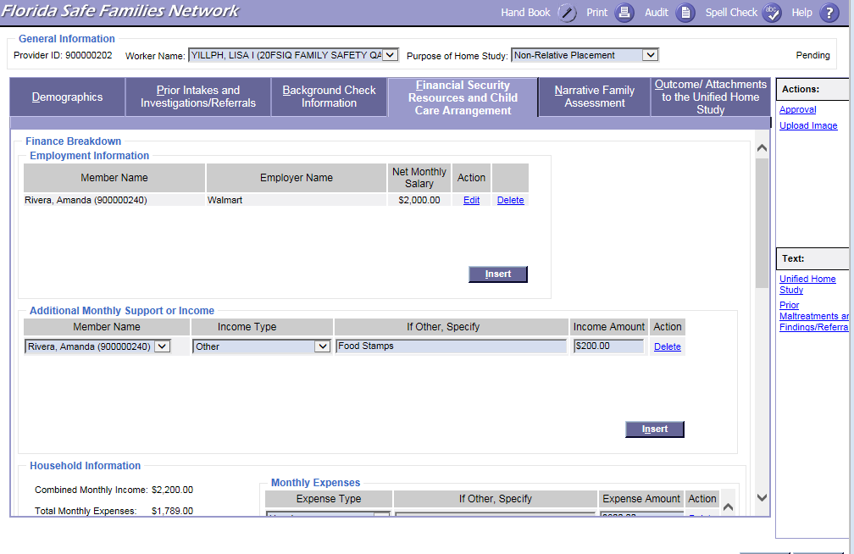
FSFN Screens
Employment Information:
Unified Home Study 2.33

Slide 34
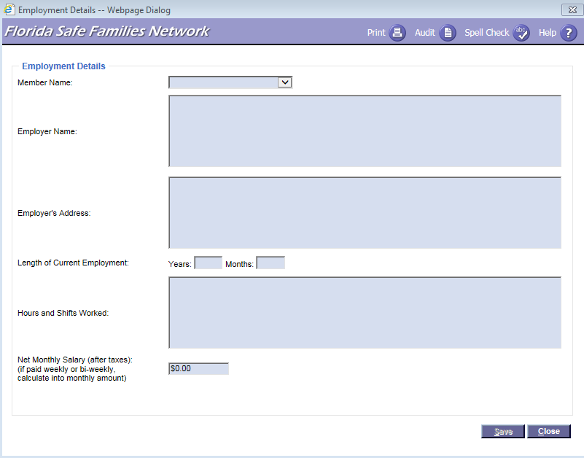
FSFN Screens
Adding Employment Details:
Unified Home Study 2.34

Slide 35
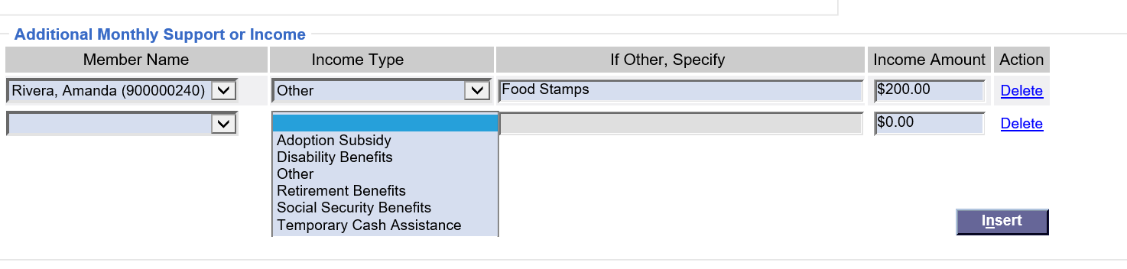
FSFN Screens
Adding Additional Monthly Support or Income:
Unified Home Study 2.35

Slide 36
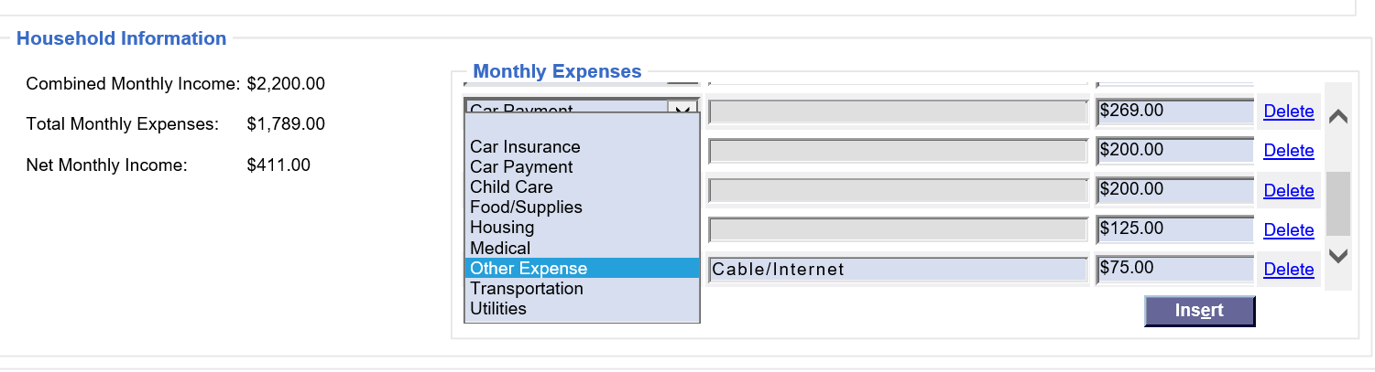
FSFN Screens
Adding Monthly Expenses:
Unified Home Study 2.36

Slide 37
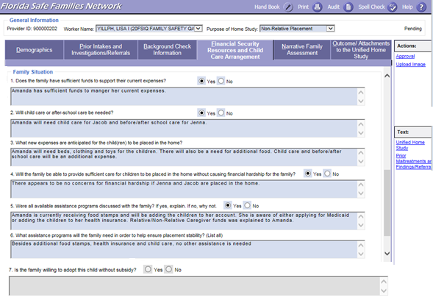
FSFN Screens
Family Situation:
Unified Home Study 2.37

Slide 38
FSFN Tutorial
Narrative Family Assessment
Unified Home Study 2.38

Slide 39
Narrative Family Assessment
CPIs must conduct a narrative family assessment and gather the needed information to fully evaluate the caregiver’s ability to provide a safe and nurturing environment for the child.
Information should be gathered through an interview process.
Unified Home Study 2.39

Slide 40
Narrative Family Assessment, con’t.
The Narrative Family Assessment is split up into nine areas:
Assess Caregiver
Family History
Child History
Motivation
Children to Be Placed Interviews
Physical Environment
Education and Employment
References and Reviews
Family Support and Resources
Unified Home Study 2.40

Slide 41
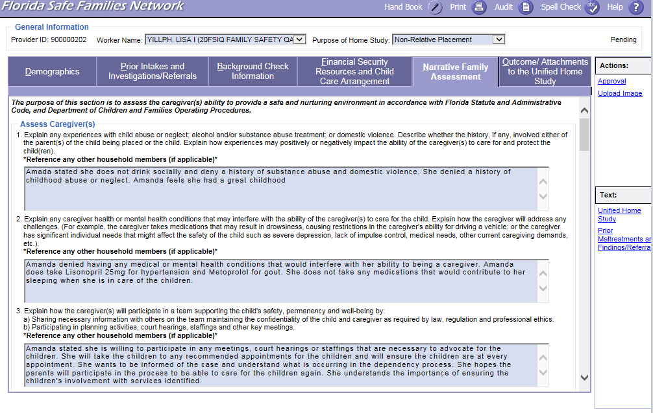
FSFN Screens
Narrative Family Assessment – Assess Caregiver(s) Questions:
Unified Home Study 2.41

Slide 42
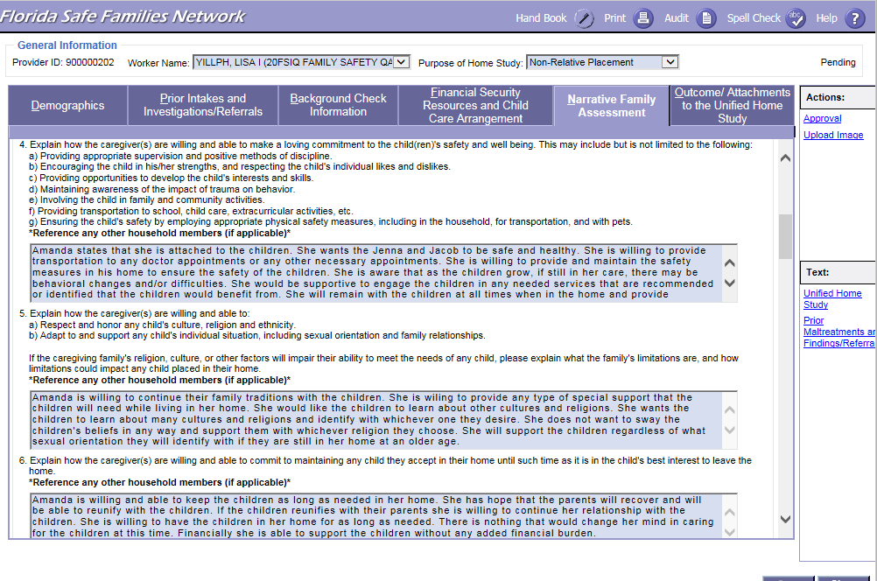
FSFN Screens
Narrative Family Assessment – Assess Caregiver(s) Questions:
Unified Home Study 2.42

Slide 43
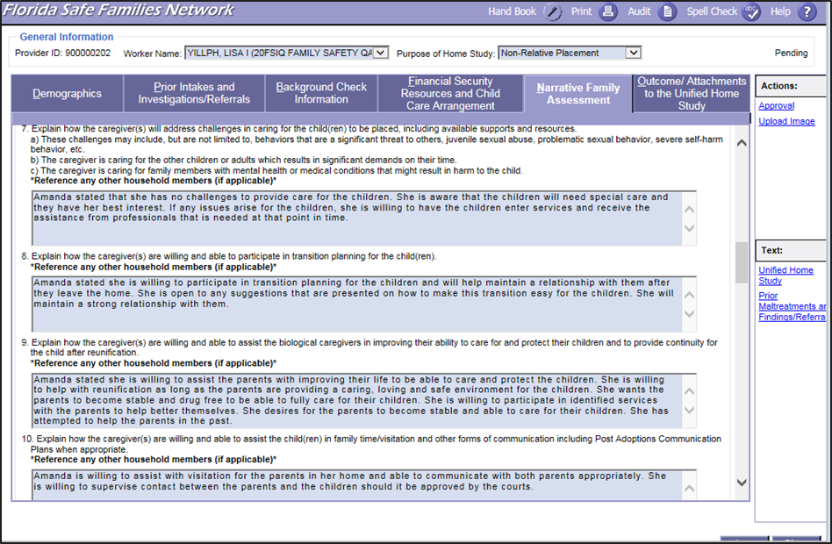
FSFN Screens
Narrative Family Assessment – Assess Caregiver(s) Questions:
Unified Home Study 2.43

Slide 44
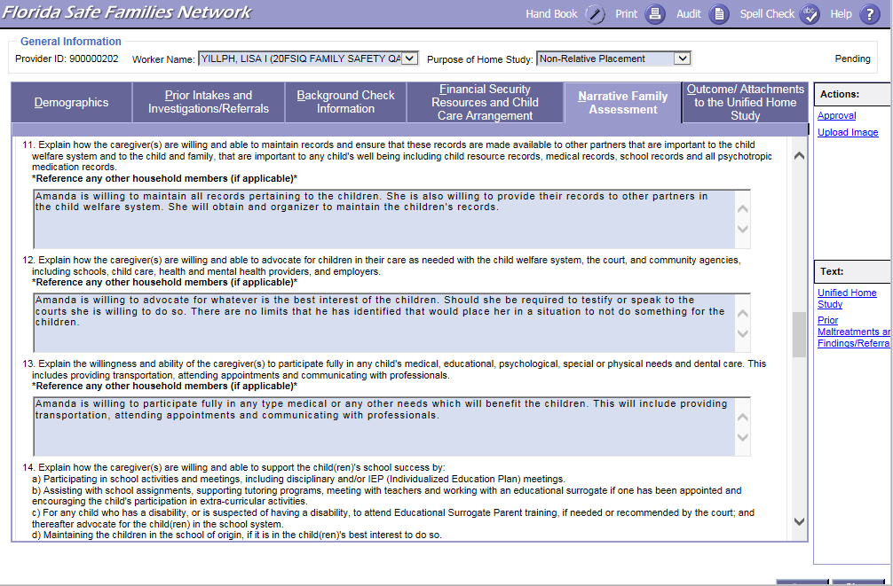
FSFN Screens
Narrative Family Assessment – Assess Caregiver(s) Questions:
Unified Home Study 2.44

Slide 45
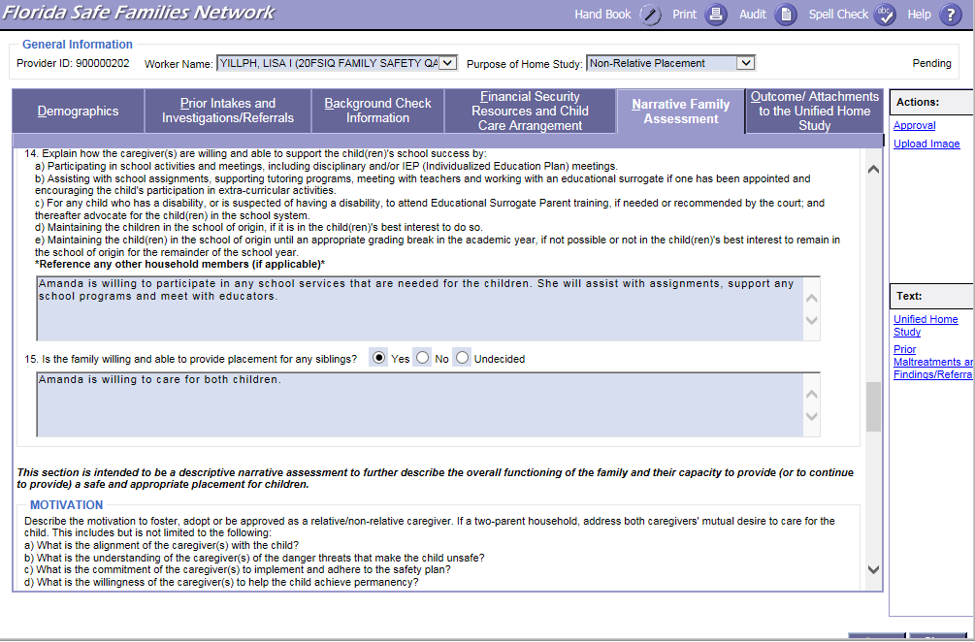
FSFN Screens
Narrative Family Assessment – Assess Caregiver(s) Questions:
Unified Home Study 2.45

Slide 46
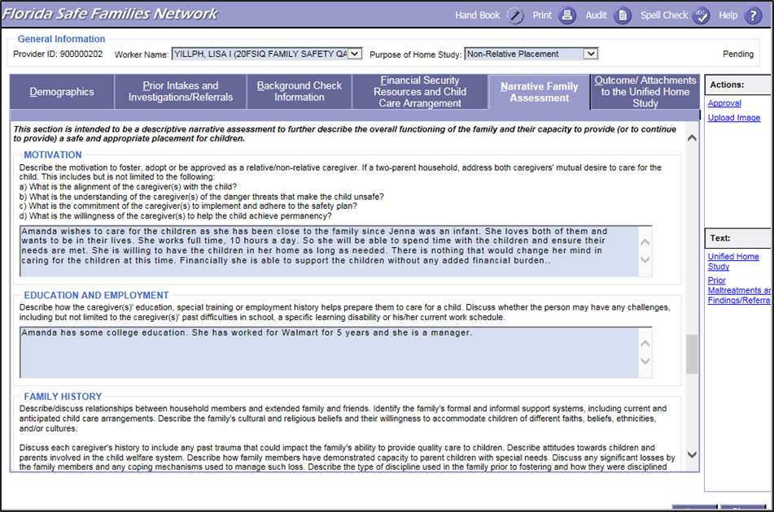
FSFN Screens
Narrative Family Assessment –
Motivation and Education and Employment:
Unified Home Study 2.46

Slide 47
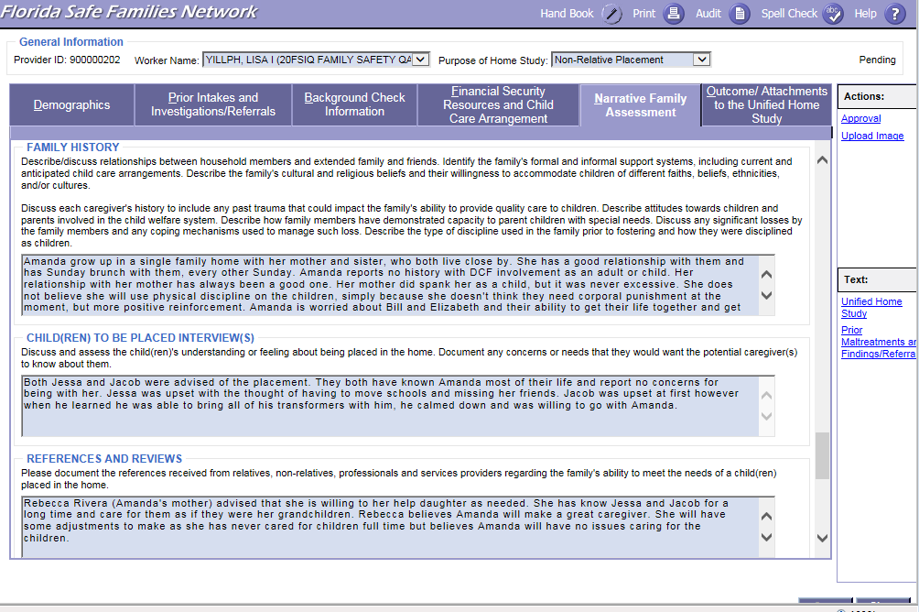
FSFN Screens
Narrative Family Assessment – Family History,
Child(ren) To Be Placed Interview(s), and References and Reviews:
Unified Home Study 2.47

Slide 48
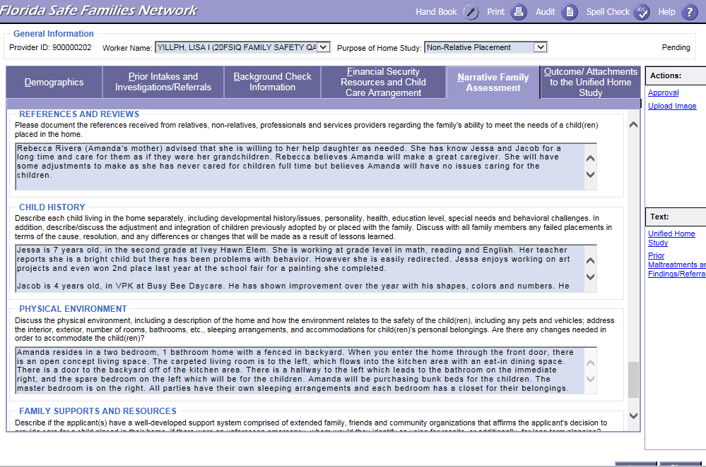
FSFN Screens
Narrative Family Assessment –
Child History and Physical Environment:
Unified Home Study 2.48

Slide 49
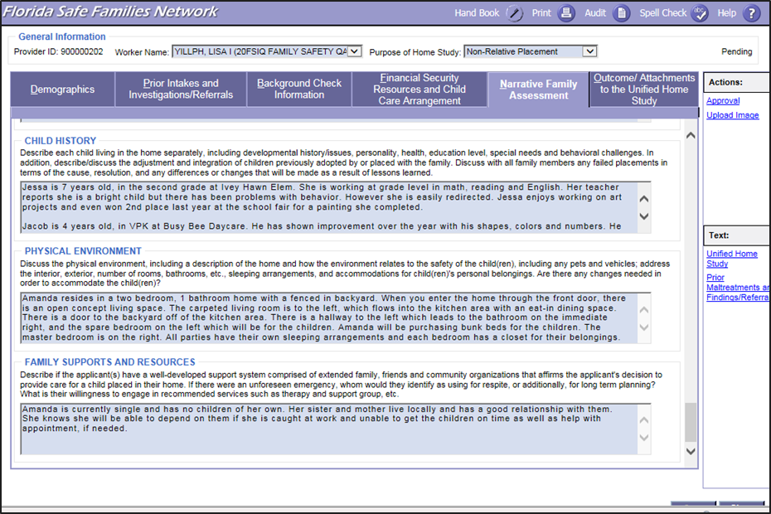
FSFN Screens
Narrative Family Assessment – Family Supports and Resources:
Unified Home Study 2.49

Slide 50
The UHS Interview Process
Goes beyond reading questions and documenting caregivers’ responses.
Requires information gathering beyond yes/no responses.
Qualitative interview skills must be used to gather the necessary information to assess the relative/non-relative caregiver(s).
Unified Home Study 2.50

Slide 51
The UHS Interview Process, con’t.
Opening
Phase
Planning
Phase
Information Gathering
Phase
Closing
Phase
Unified Home Study 2.51

Slide 52
Activity A: Part 1
Emergency! Jacob and Jenna Are in Present Danger
Read the scenario. Please note that the scenario is split into a Part A and Part B. The first part is for everyone, the second part should only be read by the Interviewee/Caregiver.
Select who will be the CPI/interviewer and who will be the Caregiver/Interviewee.
The interviewer must select up to five of the narrative assessment questions and using the four interview phases gather the needed information from the caregiver.
Unified Home Study 2.52

Slide 53
Finalizing the Emergency Placement Home Study
Once the requirements are met, and the home study is launched, the child may then be placed.
All of the required questions/information for an Emergency Placement Home Study must be gathered and assessed before determining a final recommendation.
From placement, the CPI has two business days to enter the documentation into the home study in FSFN.
Unified Home Study 2.53

Slide 54
FSFN Tutorial
Attachments
Unified Home Study 2.54

Slide 55
Attachments
Attachments provide verification of information gathered and evidence of information shared with the caregivers.
The Outcome/ Attachments tab includes attachments that are in print form and external to the UHS and/or FSFN.
The attachments that are required depend on the type of Unified Home Study being completed.
Unified Home Study 2.55

Slide 56
Upload Requirements
Attachments | Upload Requirements for Emergency Placement Home Study
Affidavit of Firearm Safety | Required: Signed Acknowledgement of Firearms/Safety Requirements
Consent to Release Information | Required: Use Agency Specific Release
Personal References | Optional to Upload Information
Referrals | Optional to Upload Information Provided to Caregiver
Receipts of Rights and Responsibilities | Optional to Upload Information Provided to Caregiver
Receipt of Grievance Brochure | Optional to Upload Information Provided to Caregiver
Water Addendum | Optional to Upload Information Provided to Caregiver
Relative Caregiver Program Information | Optional to Upload Information Provided to Caregiver
Adoption-Child Study | N/A
Adoption-Subsidy Acknowledgement form | N/A
Affidavit of Good Moral Character | N/A
Florida Adoption Assistance Program | N/A
Information Packet Sent-Adoptive Home | N/A
Information Packet Sent-Foster Home | N/A
Florida Adoption Reunion Registry | N/A
TANF Information | N/A
Unified Home Study 2.56

Slide 57
Signatures, Recommendations, and Final Approvals
Once all information required has been gathered and assessed, Child Welfare Professionals must ask the caregiver to review and sign the home study.
If known, it is at this time that Child Welfare Professionals inform the caregiver of any concerns or changes that might affect the anticipated outcome of the home study.
Signatures
Unified Home Study 2.57

Slide 58
Signatures, Recommendations, and Final Approvals, con’t.
Once signed by the caregiver(s), CPIs, and supervisors, the entire UHS, including the signature page, must be uploaded into the UHS page in FSFN within two business days.
Signatures
Unified Home Study 2.58

Slide 59
Signatures, Recommendations, and Final Approvals, con’t.
In the Recommendation group box on the FSFN UHS page, the Child Protection Investigator selects an appropriate recommendation from the Recommendation drop-down choices:
Application Withdrawn
Denied - Criminal Disqualifier
Duplicate - Created
in Error
Approved - Meets Requirements
Denied - FSFN Disqualifier
Approved - Review Comments
Denied - Review Comments
Unified Home Study 2.59

Slide 60
Signatures, Recommendations, and Final Approvals, con’t.
The supervisor reviews the home study in FSFN to determine that appropriate interviews, background checks and analysis, and assessment of caregiver(s) have been completed.
For the approval/denial process, Child Welfare Professionals and supervisors must enter a justification for approval or denial in the
Outcome text box.
Final Approvals
Unified Home Study 2.60

Slide 61
Signatures, Recommendations, and Final Approvals, con’t.
The supervisor has the authority to approve or deny a completed home study regardless of a Child Welfare Professional’s recommendation.
Final Approvals
Unified Home Study 2.61

Slide 62
Final Approvals
In the Outcome group box on the FSFN UHS page, the supervisor selects an appropriate conclusion from the Outcome drop-down choices:
Application Withdrawn
Denied - Criminal Disqualifier
Duplicate - Created
in Error
Approved - Meets Requirements
Denied - FSFN Disqualifier
Denied - Court Approved
Approved - Review Comments
Denied - Review Comments
Unified Home Study 2.62

Slide 63
Final Approvals, con’t.
The Child Welfare Professional Supervisor must approve their outcome by completing the approval routing process.
If the Child Welfare Professional’s supervisor is not available, they can choose an alternate supervisor.
Child Welfare Professionals cannot approve their own
home study.
Unified Home Study 2.63

Slide 64
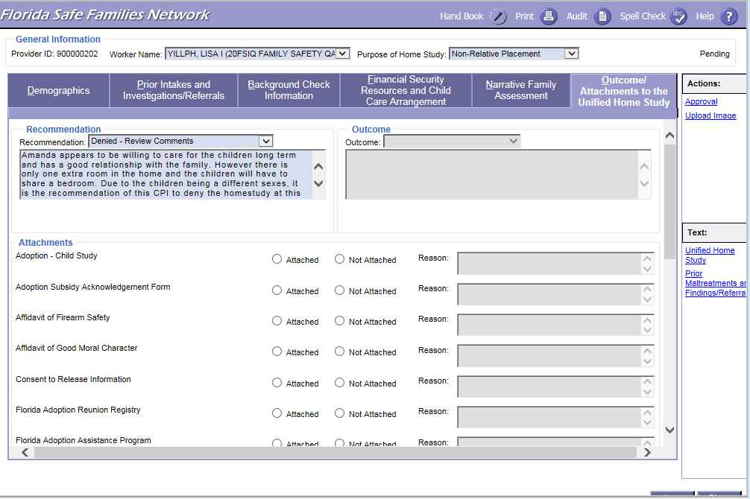
FSFN Screens
Outcome/Attachments, Recommendations, and Approval:
Unified Home Study 2.64

Slide 65
Filing with the Court
A copy of the signed home study, copies of criminal records that can be shared, and any additional attachments obtained are submitted to CLS to file with the court.
Provided to CLS in conjunction with the shelter or emergency removal hearing. If the Emergency Placement Home Study is not available at the time of hearing, it must be provided to CLS no later than the next business day after hearing.
Unified Home Study 2.65

Slide 66
FSFN Tutorial
Copy Function
Unified Home Study 2.66

Slide 67
Copy Function
The information that will copy over includes:
Purpose of home study
Narrative Family Assessment information, except for non-required questions
Finance Breakdown, Additional Monthly Support or Income, and Household Information from the Financial Security Resources tab
Other states of residence
Background check narrative
FSFN will now have the functionality to copy over selected fields from the most recent approved home study in FSFN.
If there is already a pending home study, a validation message will appear to ensure a new one is needed.
Unified Home Study 2.67

Slide 68
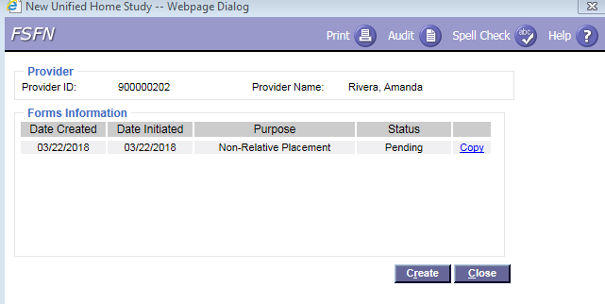
FSFN Screens
Copy Function:
Unified Home Study 2.68

Slide 69
Activity A: Part 2
Emergency! Jacob and Jenna Are in Present Danger
Read the scenario.
Create and complete Emergency Placement Home Study CPI denial and a Supervisor approval in FSFN.
Unified Home Study 2.69

Slide 70

Questions

